Slide 1

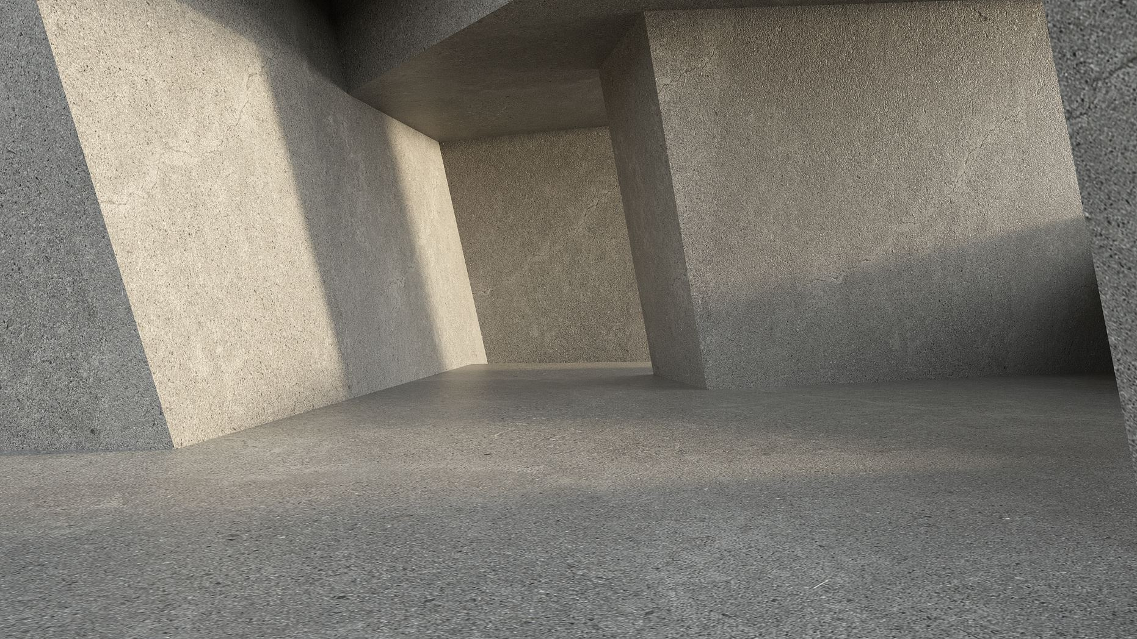
Bridging the Gap Between the Scattering Transform and Trainable CNNs
Yaaqov Mishayev
Idan sorin

Slide 2
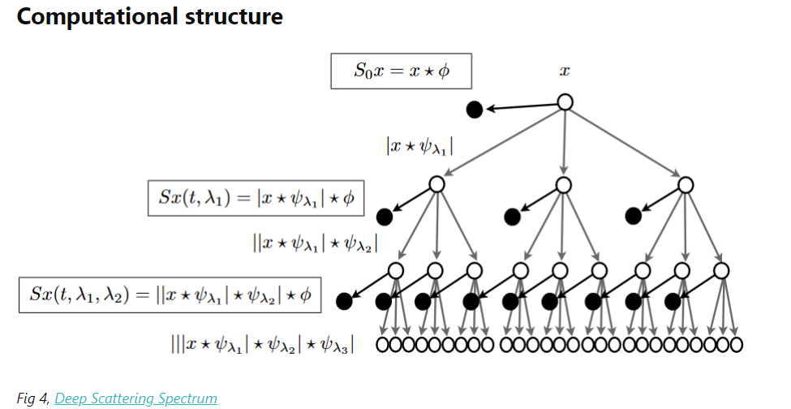
Wavelet scattering transform and why
The scattering transform was developed by Stéphane Mallat and his collaborators. Stéphane Mallat is a key figure in wavelet theory and signal processing.
Wavelet Scattering is an equivalent deep convolutional network, formed by a cascade of wavelets, modulus nonlinearities, and lowpass filters to enable you to derive, with minimal configuration, low-variance features from real-valued time series and image data for use in machine learning and deep learning applications.
It yields representations that are:
Invariant to rotation translation and scaling
Stable against time-warping deformations and shift invariant
proved its usefulness in many classification tasks and attaining SOTA (State of the Art) on limited datasets.

Slide 3
Summery of the Architecture and Properties
Convolutional filters: band-limited wavelets
Nonlinear activation: modulus (Lipschitz)
Pooling: L1 norm as averaging
A Multiscale Sparse Representation
Norm Preservation (Parseval’s identity)
Contraction

Slide 4
Convolutional vs. Scattering Network
Convolutional Neural Network
Input signal/ image
convolution
RELU
convolution
RELU
pooling
convolution
RELU
pooling
pooling
Wavelet Scattering Network
Wavelet
convolution
Wavelet
convolution
Wavelet
convolution
Input signal/ image
Nonlinearity
Averaging
Nonlinearity
Averaging
Nonlinearity
Averaging

Slide 5
Convolutional vs. Scattering Network
    The scattering transform uses predefined, non-trainable wavelet filters to extract features from input images. These filters are designed to capture multi-scale, hierarchical information in the image, similar to how convolutional layers in a CNN extract features.
    However, unlike CNNs where filters are learned during training, scattering uses fixed wavelets. The CNN, on the other hand, starts with random filters that are trained based on the data. CNNs adjust their filters to learn features specific to the task, such as classification.

Slide 6
The experiment Overview: Exploring Wavelet Scattering as CNN Initialization
In this experiment, we investigate the relationship between wavelet scattering transforms and trainable convolutional neural networks (CNNs). The key goal is to initialize a CNN with wavelet filters, train it on image classification (MNIST), and observe how much the model changes compared to the initial scattering-based version.

Slide 7
Experiment Breakdown
Step 1: Fixed Scattering Transform with Trainable Classifier We begin by using a traditional scattering transform from the Kymatio library, where the scattering filters are fixed wavelets, and only a linear classifier layer is trainable. We train this model on the MNIST dataset. This step serves as the baseline, where scattering transforms are known for their translation invariance and stability to small deformations. The filters here are not learned but predefined as wavelets.
Step 2: Trainable Wavelet Filters with Frozen Classifier In the second part of the experiment, we initialize a fully trainable CNN by treating the wavelet filters as the starting point. These wavelets now become trainable, but the linear classifier is frozen, inherited from Step 1. We train the CNN filters using an Adam optimizer and allow the model to learn from the data while keeping the classifier fixed. This allows us to see how much the wavelet filters adjust during training.
Step 3: Random Filters with Frozen Classifier In the third phase, we initialize the CNN with random(after loading the wavelet filters again) filters instead of wavelets. The classifier remains frozen, inherited from Step 1 again. This setup mimics a traditional CNN framework, but with a pre-trained classifier. By comparing this to the scattering-initialized version, we can assess how random filter initialization changes the training process.

Slide 8
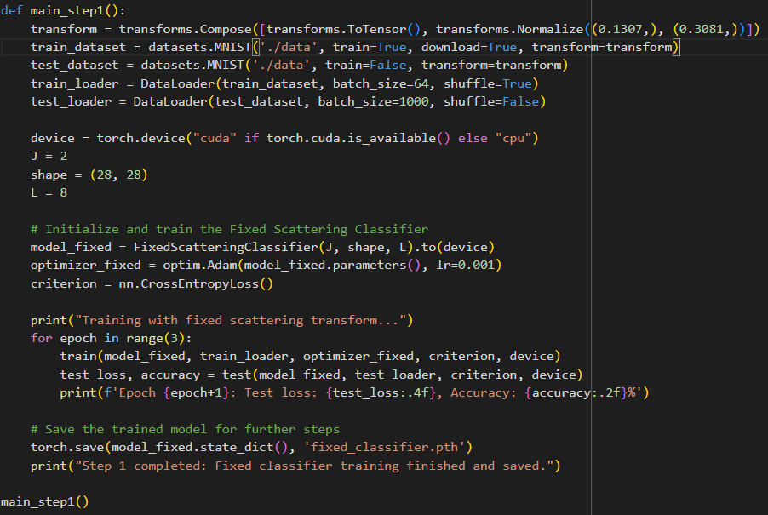
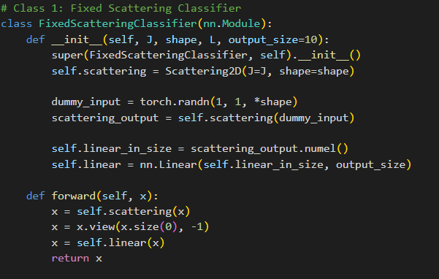
The code of the experiment step 1:
Step 1: Training a Fixed Scattering Classifier In this step, we use Kymatio and PyTorch to implement a scattering transform-based classifier for MNIST. Scattering Transform (Fixed Filters): We initialize a Scattering2D transform with fixed wavelet filters that extract translation-invariant features. The parameters, J=2 and L=8, define the scale and orientation of the filters. These filters remain non-trainable. Linear Classifier:
The scattering output is passed to a trainable linear layer that maps the features to the 10 digit classes (0-9).Training:
The model is trained on MNIST for 3 epochs using the Adam optimizer and cross-entropy loss. Only the linear layer is trained, while the scattering filters stay fixed.
Result:
This step establishes a baseline for the experiment, showing how much information can be extracted with predefined filters. The trained model is saved for use in the next steps. This provides a solid starting point to compare with the later models that involve training the wavelet filters or using random initializations.

Slide 9
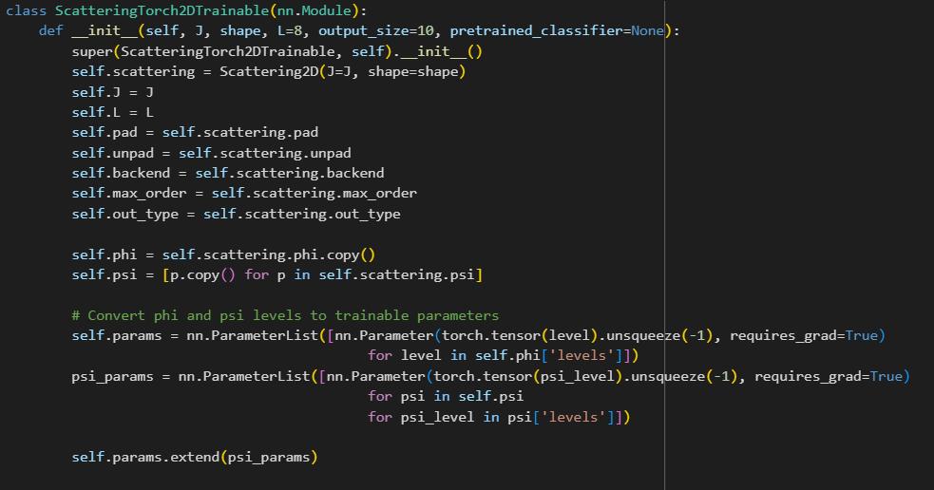
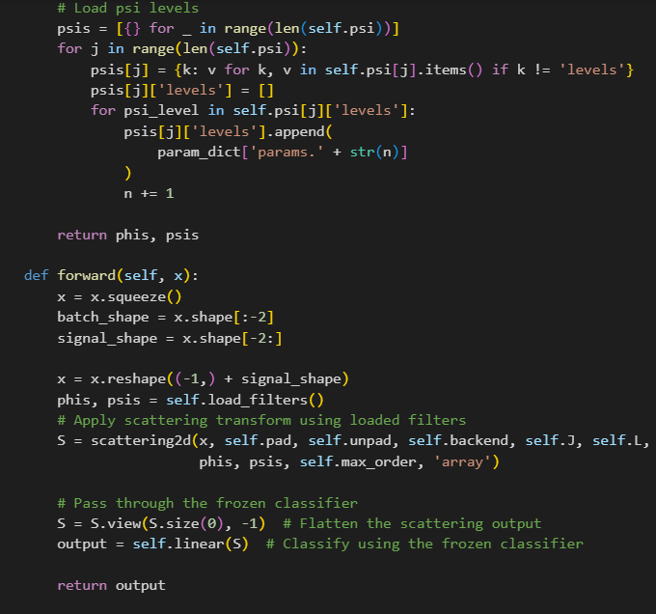
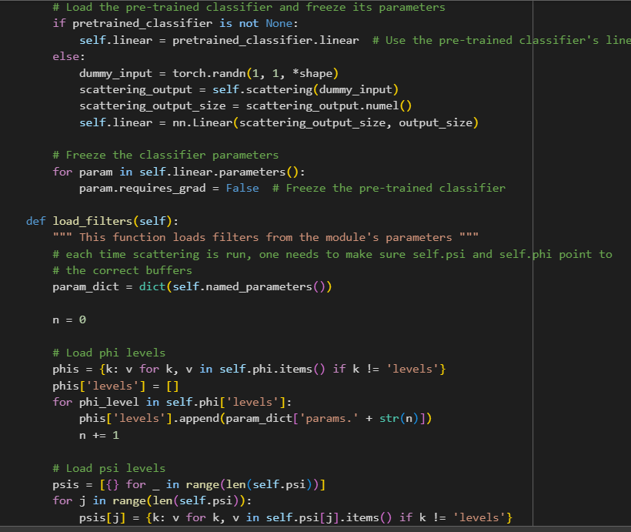
The code of the experiment step 2:
In this second part, we extend the previous model by allowing the wavelet filters from the scattering transform to become trainable, while keeping the linear classifier frozen. Here's how it works:
Trainable Scattering Filters: The wavelet filters, phi and psi, are converted into trainable parameters by wrapping them with Pytorch’s nn. Parameter. This allows the filters to be optimized using the dataset, unlike the fixed filters in Step 1.
The scattering transform is still applied, but the filters now adjust based on the data.
Frozen Classifier : The classifier from Step 1 is loaded and frozen. Its weights are inherited from the model trained in the first step, and no further updates are made to the classifier during training. This allows us to focus on how much the wavelet filters change when trained.
Training Process : We train the model on MNIST using the Adam optimizer for 3 epochs, similar to Step 1. This time, however, only the scattering filters are trained, while the classifier stays frozen. During training, we track the weight changes of the wavelet filters to measure how much they deviate from their initial values.
Tracking Changes : At the end of each epoch, we calculate how much the trained filters have changed compared to their initial scattering filter values. This is recorded as part of the experiment to understand how far the model deviates from the original scattering transform.

Slide 10
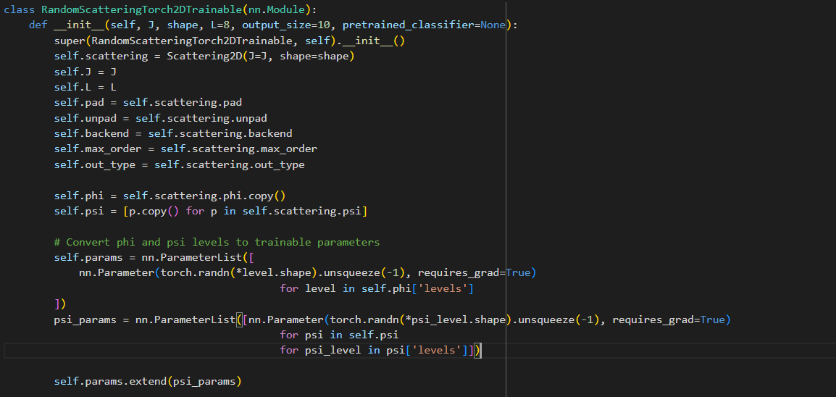
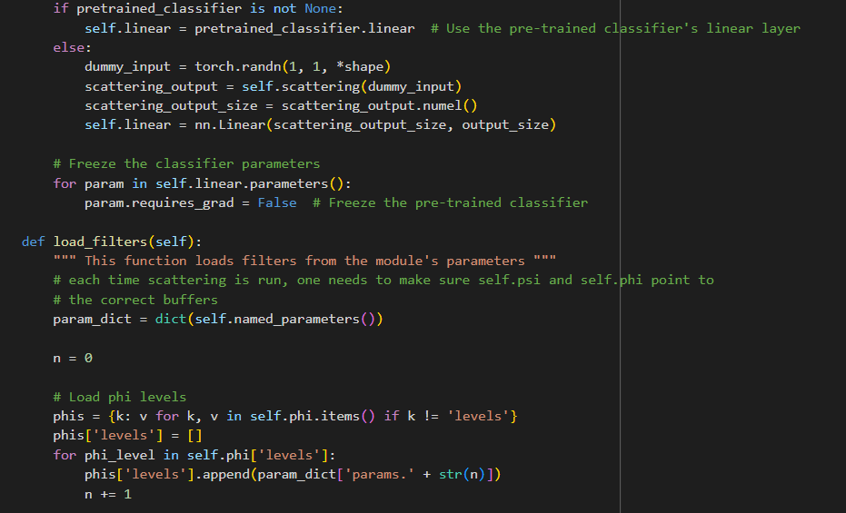
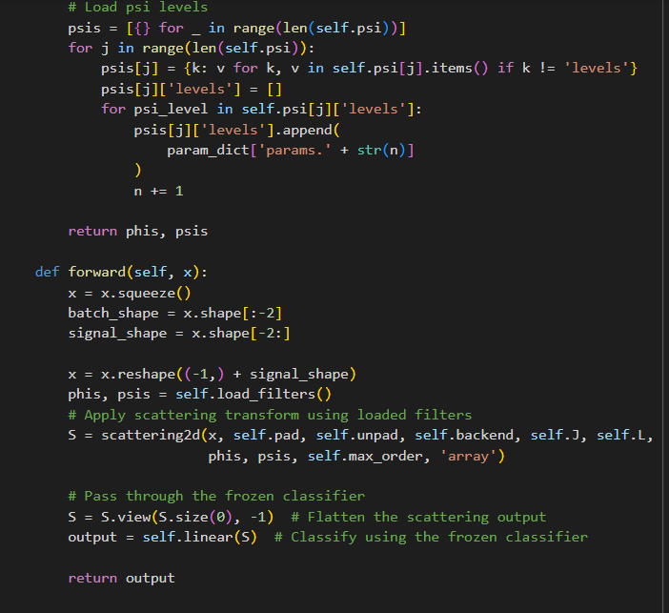
The code of the experiment step 3:
Step 3: Training with Random Filters and Frozen Classifier in this final phase, we replace the wavelet filters with randomly initialized filters, while keeping the classifier frozen, similar to the previous step.
This allows us to compare the performance of random filters to that of the wavelet-based scattering filters.
Random Initialization of Filters: Instead of using pre-defined wavelet filters, we initialize the filters (phi and psi levels) with random values. These random filters will be trained to optimize the model’s performance on MNIST.
The model structure remains the same, but the filters start with random values, behaving like a traditional CNN.

Slide 11
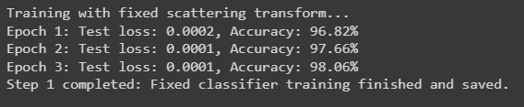
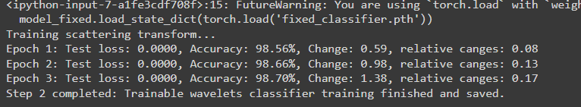
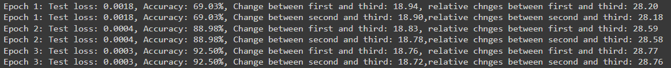
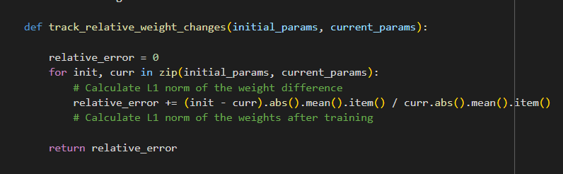
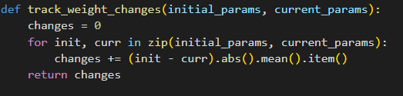
Results
The model is trained with a fixed scattering transform, and performance improves with each epoch, achieving high accuracy by the third epoch.
This model allows wavelet filters to be trainable. The accuracy is quite high from the start, and there is a a little bit L1 norm weights changes and a relateve weights changes are bigger and around 20-70 This model starts with random scattering wavelets, resulting in a much lower accuracy initially, but quickly improves with training, achieving accuracy by the third epoch. The weight changes here are much larger than in the trainable scattering transform case and the relative changes here are much bigger ( around 7-5 times bigger)
Note: every time you run the code the changes are different, but the difference are minor
The metric :

Slide 12
Conclusion
The results of the first model are promising.
The second model shows even better results, although the changes in the weights (parameters) are minimal.
In the third model, the results are less favorable, but by the third epoch, the gaps in the results start to narrow. However, the performance of the model with randomly initialized filters (similar to how a traditional CNN works) is still inferior, with more significant changes in the parameters.
Therefore, there are discrepancies in the parameters when the filters are trained randomly compared to non-random filters. Additionally, when we train the random filters, the parameters differ more significantly compared to when we don’t train them in the first model. This makes sense, as training the non-random filters results in parameters that differ slightly from those in the first model.
As a result, we observe differences in both the outcomes and the parameters when treating our network in the third part as a traditional CNN.

Slide 13
Bibliography
1. Lecture notes: Convolutional Networks on Grids and Graphs: Mathematical Analysis from a Signal Processing Perspective , Ron Levie.
2. YouTube video: Wavelets-based Feature Extraction - Part2: Wavelet Scattering Transform , Rami Khushaba.
3. Kymatio: Scattering Transforms in Python, St´ephane Mallat, Journal of Machine Learning Research 21 (2020) 1-6.
4. Generic Deep Networks with Wavelet Scattering, Edouard Oyallon, Stephane Mallat, Laurent Sifre, Ecole Normale Sup´erieure, 45 rue d’Ulm, 75005 Paris, France 2014.
5. Invariant Scattering Convolution Networks, Joan Bruna & Stephane Mallat, 2012.
6. An Introduction to Convolutional Neural Networks, Keiron O’Shea & Ryan Nash 2, 2015.

